Slide 1
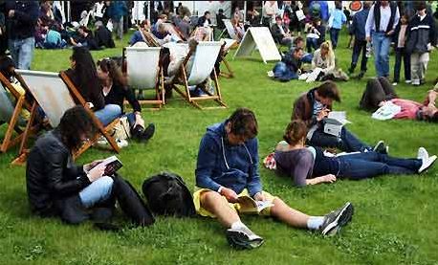
…HELLO THERE!
Pull out your Silent Reading books and enjoy 15 minutes of silent reading!

Slide 2
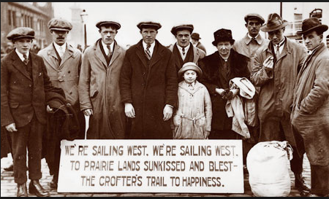
DRAFTING THE ESSAY
MODERN LIT AND THE AMERICAN THE DREAM

Slide 3
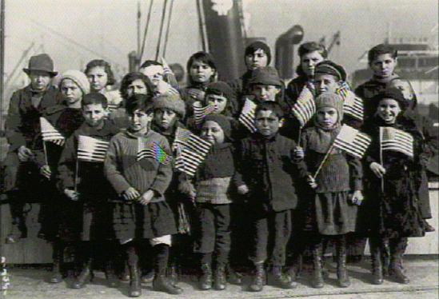
Opening
Check In –
Share your BEST concrete detail for each of the body paragraphs on the front board
Daily Objective
To complete a working draft of your Modern Lit / Humanitas essay

Slide 4
How should it look?
Here is how one body paragraph might be structured:
First, discuss how modernization and capitalism affected daily life.
TS: The opportunities to make money quickly were available at every turn during the 19020s.

Slide 5
TS: The opportunities to make money quickly were available at every turn during the 19020s.
Then, your history CDs…
CD: For example, “new technologies, soaring business profits, and higher wages allowed more and more Americans…” (sparknotes.com) purchasing power and disposable income.
CD: Furthermore, “the increasing availability of consumer goods pushed modernization forward, and the US economy began to shift…toward the production of commodities” (sparknotes.com)

Slide 6
TS: The opportunities to make money quickly were available at every turn during the 1920s.
CD: For example, “new technologies, soaring business profits, and higher wages allowed more and more Americans…” (sparknotes.com) purchasing power and disposable income.
CD: Furthermore, “the increasing availability of consumer goods pushed modernization forward, and the US economy began to shift…toward the production of commodities”. (sparknotes.com)
Then, your history CM
CM: The booming economy and increasing proliferation of disposable wealth allowed Americans the chance to move easily through the social classes.

Slide 7
TS: The opportunities to make money quickly were available at every turn during the 1920s.
CD: For example, “new technologies, soaring business profits, and higher wages allowed more and more Americans…” (sparknotes.com) purchasing power and disposable income.
CD: Furthermore, “the increasing availability of consumer goods pushed modernization forward, and the US economy began to shift…toward the production of commodities”. (sparknotes.com)
CM: The booming economy and increasing circulation of disposable wealth allowed Americans the chance to move easily through the social classes.
Now, your English CD
CD: Edwin Arlington Robinson, however, addresses the factions that developed as a result of the skyrocketing upward mobility for some. Richard Corey's acquaintances and neighbors begrudge Corey's seeming effortless wealth, “[waiting] for the light, [going] without the meat, and [cursing] the bread” (Robinson, lines 13-15).

Slide 8
TS: The opportunities to make money quickly were available
at every turn during the 1920s.
CD: For example, “new technologies, soaring business profits, and higher wages allowed more
and more Americans…” (sparknotes.com) purchasing power and disposable income.
CD: Furthermore, “the increasing availability of consumer goods pushed modernization forward,
and the US economy began to shift…toward the production of commodities”. (sparknotes.com)
CM: The booming economy and increasing circulation of disposable wealth allowed Americans
to move easily through the social classes.
CD: Edwin Arlington Robinson, however, addresses the factions that developed as a result of the
skyrocketing upward mobility for some. Richard Corey's acquaintances and neighbors begrudge
Corey's seeming effortless wealth, “[waiting] for the light, [going] without the meat, and [cursing]
the bread” (Robinson, lines 13-15).
And the English CMs...
CM: Due to their own apparent inability to acquire the same luxuries as Corey, the townspeople
come to resent their own poverty all the more.
CM: The opportunity to become wealthy, while available, was not equitably distributed, leaving the
space between the “haves” and the “have nots” growing wider.

Slide 9
TS: The opportunities to make money quickly were available at every
turn during the 1920s.
CD: For example, “new technologies, soaring business profits, and higher wages allowed more
and more Americans…” (sparknotes.com) purchasing power and disposable income.
CD: Furthermore, “the increasing availability of consumer goods pushed modernization forward,
and the US economy began to shift…toward the production of commodities”. (sparknotes.com)
CM: The booming economy and increasing circulation of disposable wealth allowed Americans
to move easily through the social classes.
CD: Edwin Arlington Robinson, however, addresses the factions that developed as a result of the
skyrocketing upward mobility for some. Richard Corey's acquaintances and neighbors begrudge
Corey's seeming effortless wealth, “[waiting] for the light, [going] without the meat, and [cursing]
the bread” (Robinson, lines 13-15).
CM: Due to their own apparent inability to acquire the same luxuries as Corey, the townspeople
come to resent their own poverty all the more.
CM: The opportunity to become wealthy, while available, was not equitably distributed, leaving
the space between the “haves” and the “have nots” growing wider.
And the CS...
CS: Regardless of the opportunities at hand, ultimately not everyone was able to benefit from the
booming economy of the 1920s.

Slide 10
The opportunities to make money quickly were available at every turn during the
1920s. For example, “new technologies, soaring business profits, and higher wages
allowed more and more Americans…” (sparknotes.com) purchasing power and
disposable income. Furthermore, “the increasing availability of consumer goods
pushed modernization forward, and the US economy began to shift…toward the
production of commodities”. (sparknotes.com) The booming economy and increasing
circulation of disposable wealth allowed Americans to move easily through the social
classes. Edwin Arlington Robinson, however, addresses the factions that developed
as a result of the skyrocketing upward mobility for some. Richard Corey's
acquaintances and neighbors begrudge Corey's seeming effortless wealth, “[waiting]
for the light, [going] without the meat, and [cursing] the bread” (Robinson, lines
13-15). Due to their own apparent inability to acquire the same luxuries as Corey,
the townspeople come to resent their own poverty all the more. The opportunity to
become wealthy, while available, was not equitably distributed, leaving the space
between the “haves” and the “have nots” growing wider. Regardless of the
opportunities at hand, ultimately not everyone was able to benefit from the booming
economy of the 1920s.

Slide 11
By the end of class today…
…I will be checking for FIVE COMPLETED paragraphs!

